Slide 1
Identification and quantification of Major Carotenoids in Mysis diluviana by Capillary Electrophoresis
Matthew Hanks
Supervisor: Dr. Louis Gosselin
Co-supervisor: Dr. Kingsley Donkor

Slide 2
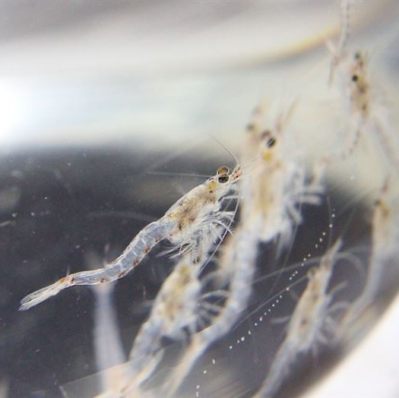
Mysis diluviana
Mysis diluviana is a shrimp-like crustacean found in freshwater lakes of northern North America and was introduced into Okanagan and Kalamalka lakes in the mid-1960s.
As part of a plan developed by the BC government in the 1990s to help the Okanagan Lake Kokanee population recover, the BC government authorized the harvesting of the invasive M. diluviana from Okanagan Lake.
The harvested M. diluviana is primarily being used as fish food in the aquarium industry; however, reports suggest M. diluviana from Okanagan Lake might also constitute a superior source of nutrition for captive fish reared in hatcheries relative to other commercially available fish foods.
Carotenoids are one of the most common types of natural pigments and can influence the colors of living organisms.
Many carotenoids are known to improve the antioxidative stress and immune system of an organism, resulting in improved disease resistance, growth performance, and survival.
Carotenoids are also responsible for the orange-red coloration in the muscle tissues of trout and salmon.
The major carotenoids that I will be analyzing are astaxanthin, beta-carotene, canthaxanthin, and lutein.

Slide 3
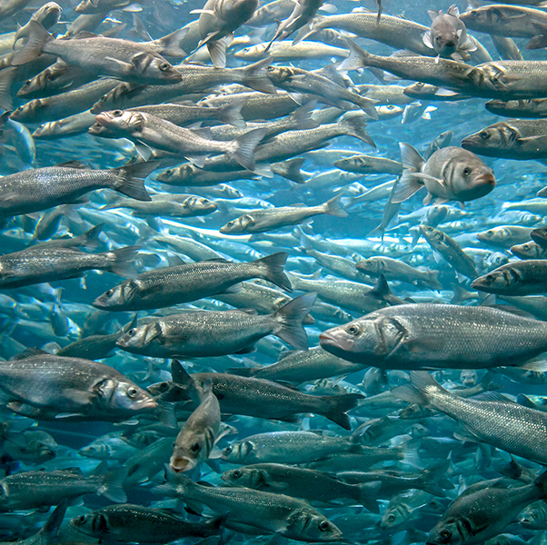
Why this Research is Important
Commercial fish feed is traditionally made with small, bony fish species such as herring and sardines.
Fish are used since the feed requires high levels of proteins, vitamins, and other nutrients.
Herring and sardines have been overfished significantly which has had a significant impact on marine ecosystems.

Slide 4
Goals
Develop a capillary electrophoresis method using an aqueous buffer
Identify and quantify the major carotenoids in Mysis Diluviana Samples

Slide 5
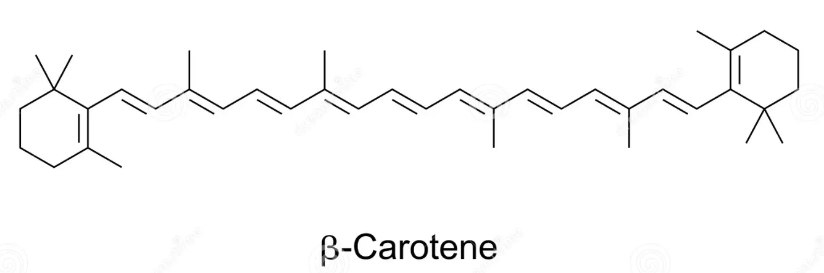
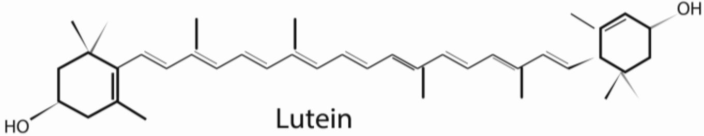
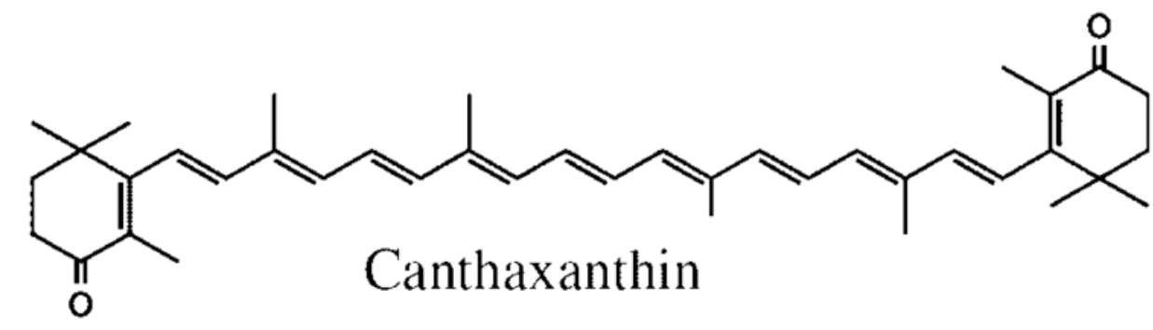
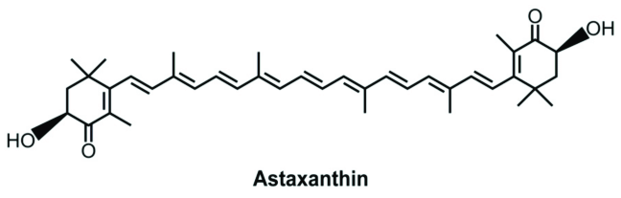
Carotenoids

Slide 6
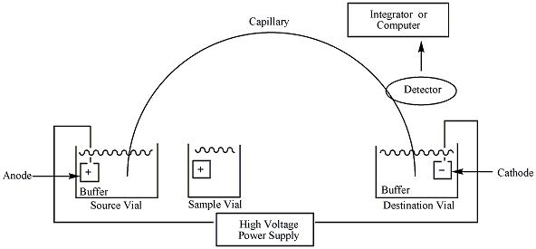
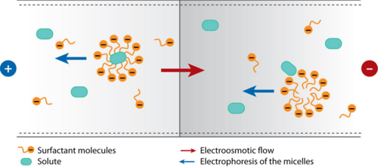
Capillary Electrophoresis

Slide 7
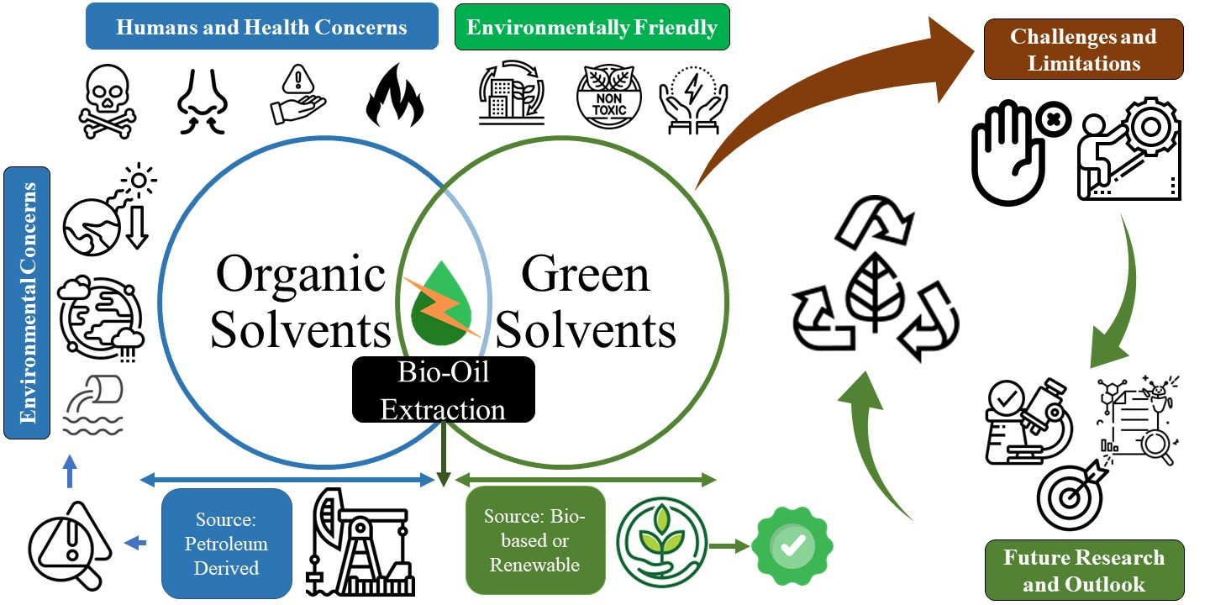
Existing Methods in Literature
There are capillary electrophoresis methods to detect and quantify carotenoids.
Existing methods use organic solvents such as benzene, acetone, and acetonitrile.
There are very few methods that give high accuracy results that use aqueous solvents.

Slide 8
Organic buffer vs Aqueous Buffer
Organic Buffer
Aqueous Buffer

Slide 9
Optimization of Buffer Conditions
pH 10.0
pH 9.5
pH 9.0
pH 8.5

Slide 10
Optimized Conditions

Slide 11
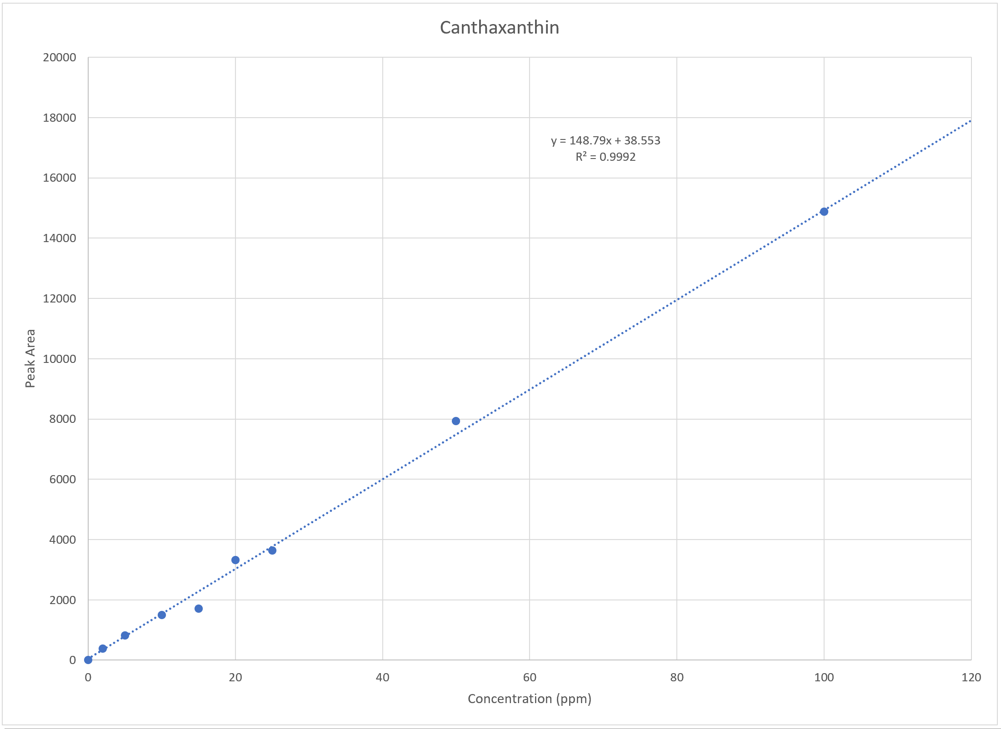
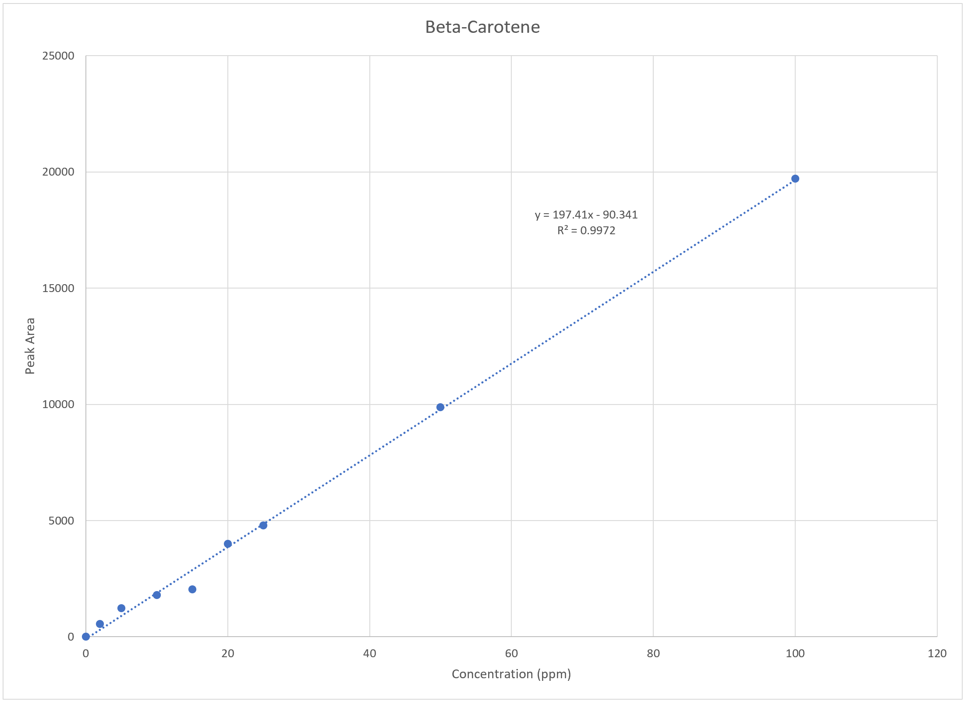
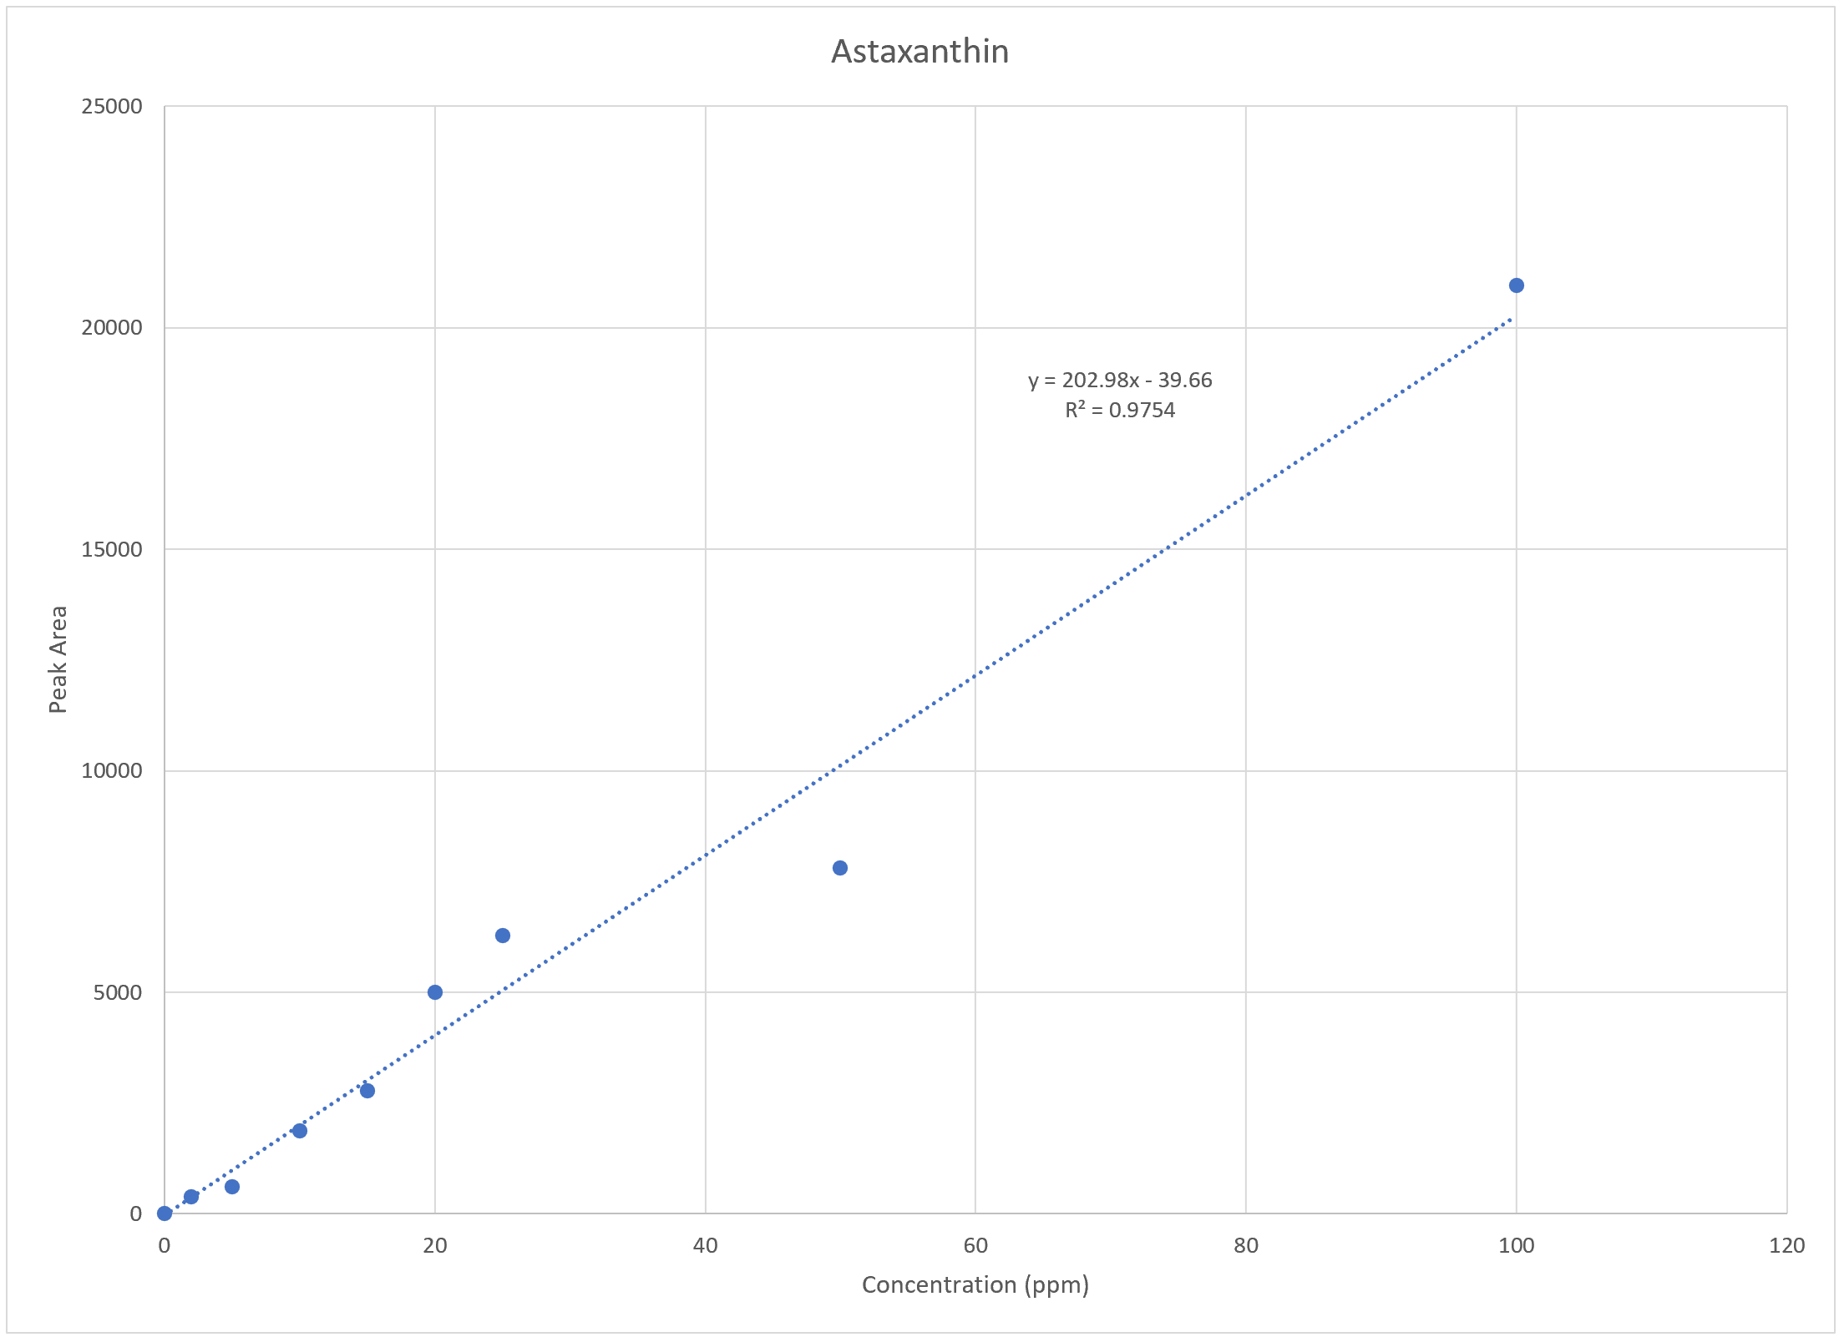
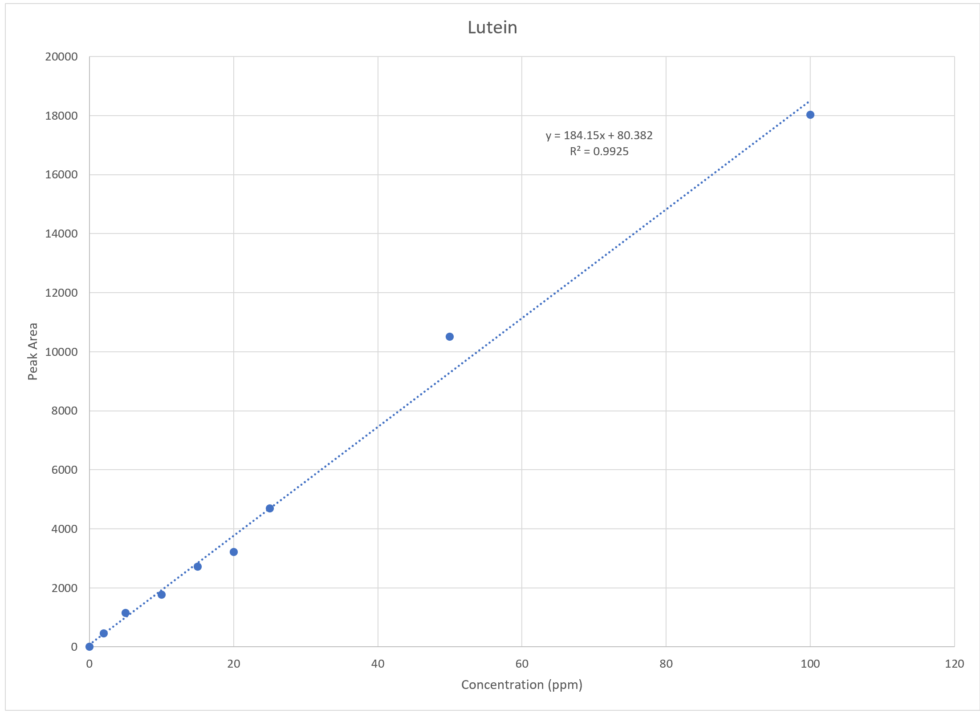
Calibration Curves

Slide 12
Future Work
1) Separation of Peaks
2) Extraction of Carotenoids

Slide 13

Questions?

